Slide 1
Drug Mortality and Socio-Economic conditions in Connecticut
Sandhya Govindaraju, Monica James, Yayun (Aaron) Liu, Alisha Pandhi

Slide 2
Project Description
We were looking to analyze trends in drug overdose death rates in Connecticut by:
Income
Age
Education
Gender
Geo-location (counties)
Unemployment rates
Barriers to medical treatment
Drug

Slide 3
Data Sources

Slide 4
Struggles with data
We were not able to find reliable data to analyze and plot these trends:
Drug-induced mortality rates and income
Drug-induced mortality rates and education

Slide 5
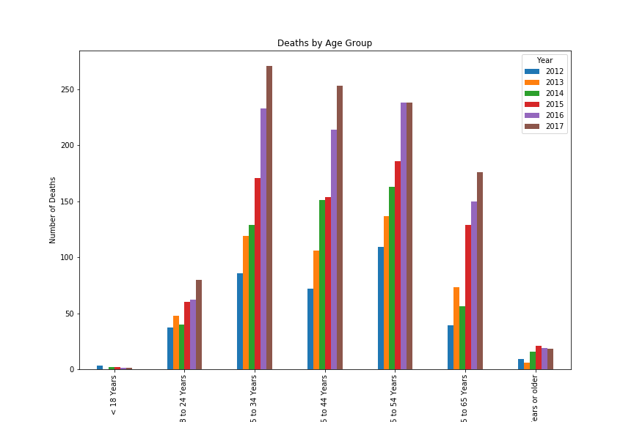
Drug-Induced Mortality Rates and Age

Slide 6
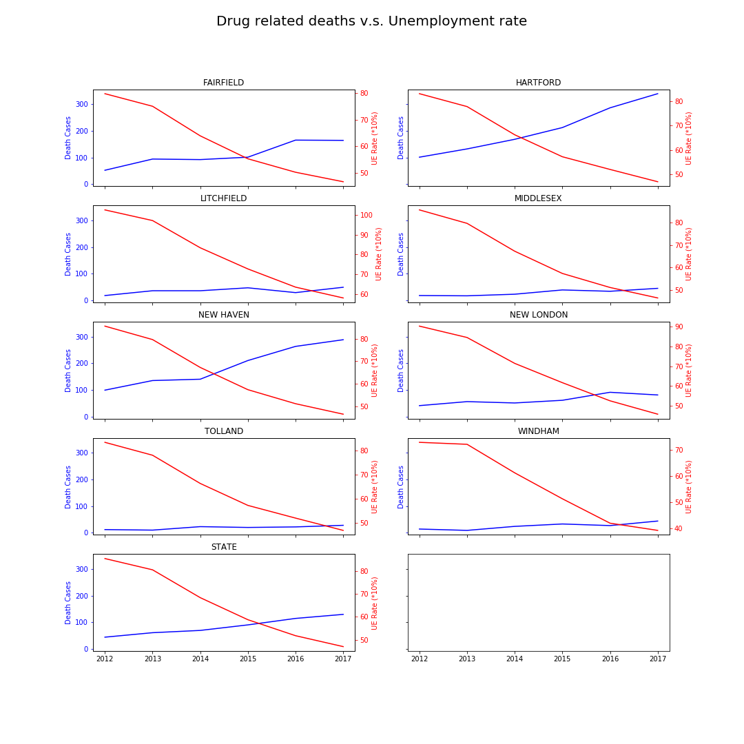
Drug-induced Mortality and Unemployment rates

Slide 7
Drug-induced mortality rates and barriers to medical treatment

Slide 8
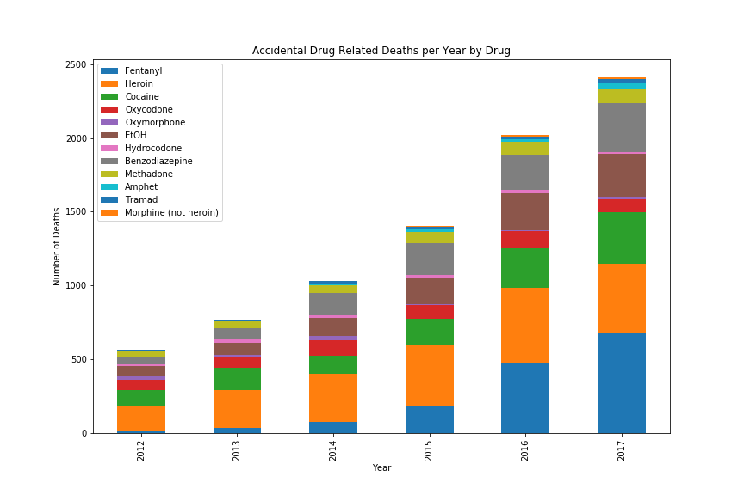
Drug-Induced Mortality Rates by Drug

Slide 9
Fentynal

Slide 10
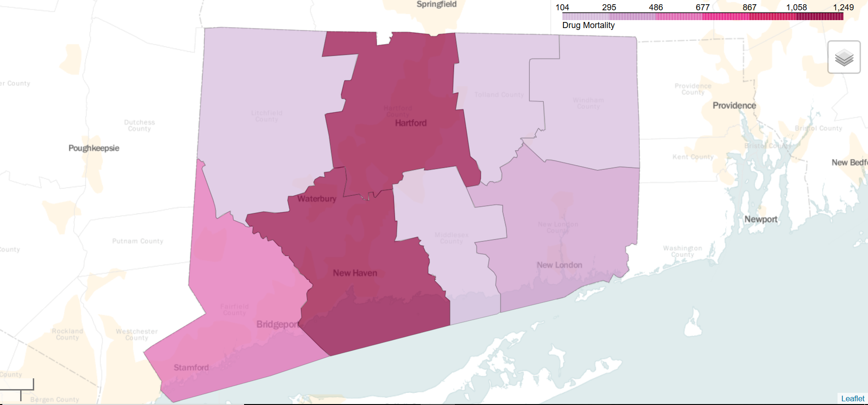
Drug-Induced Total Mortality by County

Slide 11
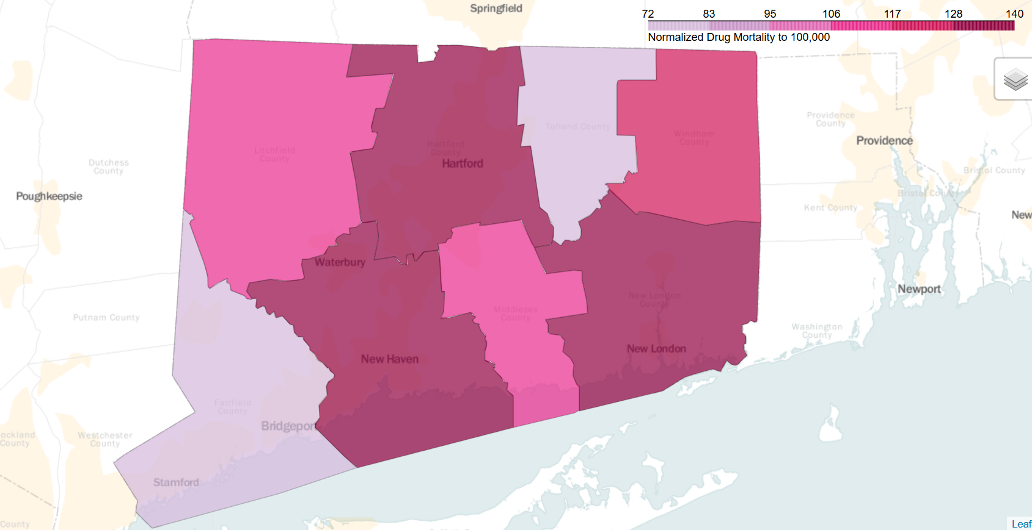
Drug-Induced Mortality by County per 100K

Slide 12
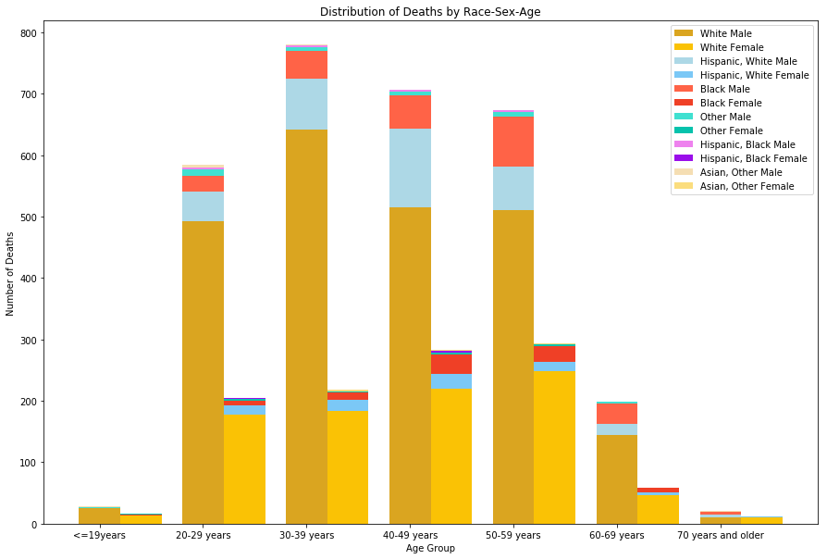
Drug-Induced Mortality by Gender, Race, and Sex

Slide 13
Drug-Induced Mortality by Gender, Race, and Sex
Race | General Population | Drug Mortality | Estimate
White | 71.20% | 3242 | 2904.248
Hispanic, White | 6.30% | 432 | 256.977
Black | 9.40% | 329 | 383.426
Hispanic, Black | 0.80% | 17 | 32.632
Asian | 3.80% | 14 | 155.002
Other | 8.50% | 45 | 346.715
Age Group | Male Population | Male Drug Mortality | Estimate
20-29 | 19.87% | 584 | 584.5754
30-39 | 18.61% | 780 | 547.5062
40-49 | 23.97% | 706 | 705.1974
50-59 | 22.71% | 673 | 668.1282
60-69 | 14.82% | 199 | 436.0044
Chi-Squared test on both cases gives a p-value of 0, confirming alternate hypothesis (some groups are affected more than others).

Slide 14
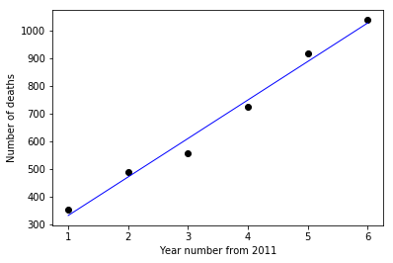
Drug-induced Mortality by Year
Fitting linear regression:
Independent variable: Year number
Dependent variable : Number of deaths in that year
Intercept = 193.33, Slope = 139
Prediction for 2018 = 1166 deaths

Slide 15
Questions?

